Slide 1
UNIT - II
WLAN

Slide 2
Introduction
A local area network (LAN) is a group of computers and associated devices that share a common communications line or wireless link to a server.
A wireless local area network (WLAN) is a wireless computer network that links two or more devices using a wireless distribution method (often spread spectrum or OFDM radio) within a limited area such as a home, school, computer laboratory, or office building.

Slide 3
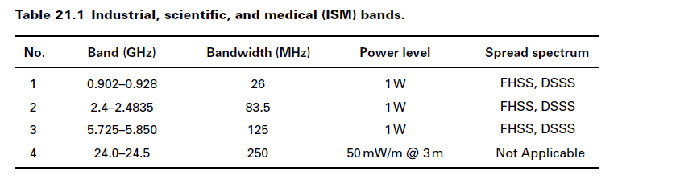

Slide 4
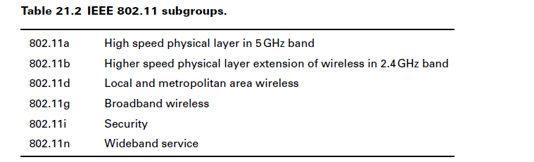
IEEE 802.11 standards are used in WLAN

Slide 5
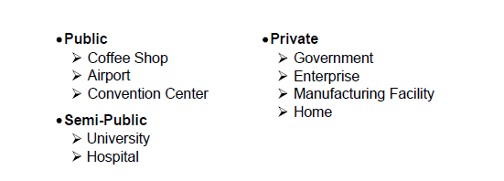
Applications of WLAN

Slide 6
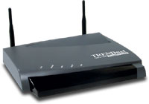
802.11 Wireless LAN
Provides network connectivity over wireless media
An Access Point (AP) is installed to act as Bridge between Wireless and Wired Network
The AP is connected to wired network and is equipped with antenna to provide wireless connectivity
Network connectivity to the legacy wired LAN
Desktop
with PCI 802.11 LAN card
Access Point
Laptop
with PCMCIA 802.11 LAN card

Slide 7
802.11 Wireless LAN
Range ( Distance between Access Point and WLAN client) depends on structural hindrances and RF gain of the antenna at the Access Point
To service larger areas, multiple APs may be installed with a 20-30% overlap
A client is always associated with one AP and when the client moves closer to another AP, it associates with the new AP (Hand-Off)

Slide 8
Benefits of Wireless LAN
Productivity, convenience, and cost advantages
Installation speed and simplicity.
Installation flexibility.
Reduced cost-of-ownership.
Mobility.
Scalability.

Slide 9
Benefits of Wireless LAN
Installation speed and simplicity
No cable to pull.
Eliminates current architecture obstacles.
Few transmitters/receivers for multiple for users.

Slide 10
Benefits of Wireless LAN
Installation flexibility
The network goes where wires cannot.
Not constrained by expensive walls.
Easy to add more computers and devices.

Slide 11
Benefits of Wireless LAN
Reduced cost-of-ownership
Mobile devices are less expensive than computer workstations.
Can “Run Errands” and stay in touch.
No need to build wiring closets.

Slide 12
Benefits of Wireless LAN
Mobility
Access to real-time information.
Supports productivity.
Provides service opportunities.
Promotes flexibility.

Slide 13
Benefits of Wireless LAN
Scalability
Spans a variety of topologies.
Configurations are easily changed.
Works over great distances.
Effective for wide range of user communities.
Small number of users with local needs.
Full infrastructure networks roaming over a broad area.
http://www.WirelessLAN.com

Slide 14
Disadvantage of Wireless LAN
Cost
Wireless network cards cost 4 times more than wired network cards.
The access points are more expensive than hubs and wires.
Signal Bleed Over
Access points pick up the signals of adjacent access points or overpower their signal.

Slide 15
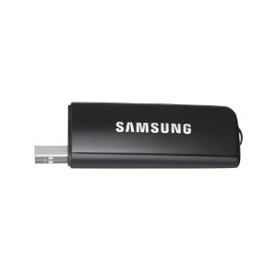
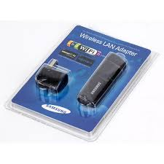
WLAN Equipment
Main Links form basis of wireless network
LAN adapter : Enables end users to access the network.
It provides an interface between the network OS and an antenna to create a transparent connection to the network

Slide 16
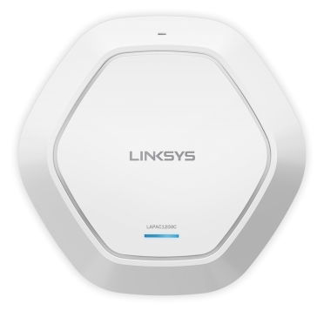
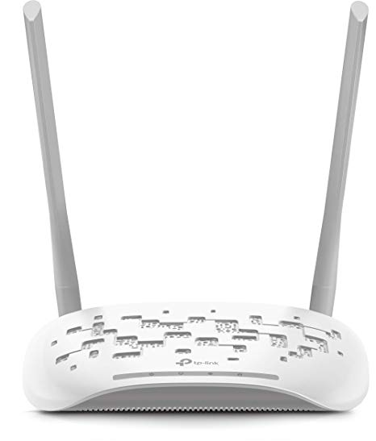
Access Point
Short for Access Point, a hardware device or a computer's software that acts as a communication hub for users of a wireless device to connect to a wired LAN.
APs are important for providing heightened wireless security and for extending the physical range of service a wireless user has access to.

Slide 17
Infrastructure Mode
An 802.11 networking framework in which devices communicate with each other by first going through an (AP).
Ex. : WIFI
In infrastructure mode, wireless devices can communicate with each other or can communicate with a wired network.
When one AP is connected to wired network, a set of wireless stations it is referred to as a Basic Service Set (BSS).

Slide 18
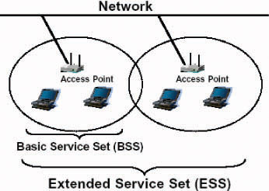
Infrastructure Mode
An Extended Service Set (ESS) is a set of two or more BSSs that form a single subnetwork.
Most corporate wireless LANs operate in infrastructure mode because they require access to the wired LAN in order to use services such as file servers or printers.

Slide 19
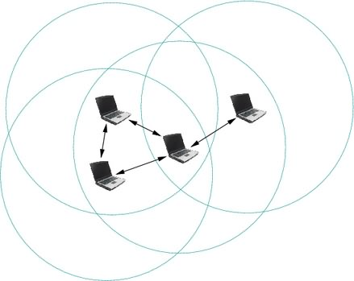
Ad-hoc Mode
An 802.11 networking framework in which devices or stations communicate directly with each other, without the use of an access point.
Ad-hoc mode is also referred to as peer-to-peer mode or an Independent Basic Service Set (IBSS).
Ad-hoc mode is useful for establishing a network where wireless infrastructure does not exist or where services are not required.

Slide 20
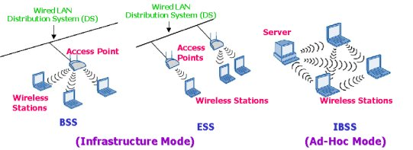
Access Point
It receives, buffers and transmits data between WLAN and wired networks supporting group of wireless user devices.

Slide 21
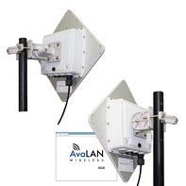
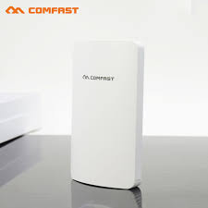
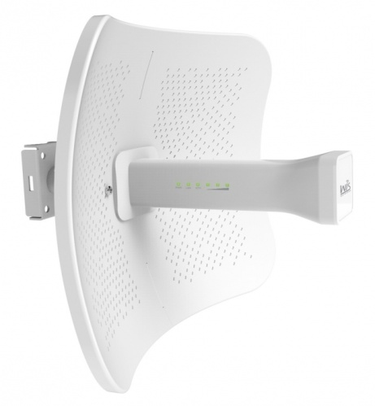
Outdoor wireless LAN Bridge :
used to connect LANs in different buildings.
It supports high data rates with range of several (30) miles using line of sight directional antennas.
Some APs can also act as a bridge between devices with close proximity.

Slide 22
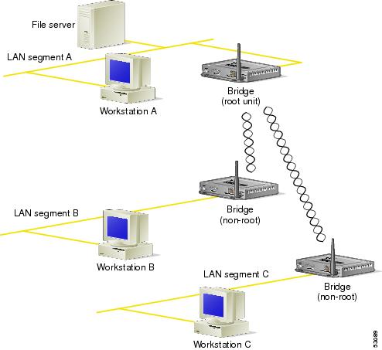

Slide 23
WLAN Topologies
Three types of WLAN topologies:
Independent basic service sets (IBSSs)
Basic service sets (BSSs)
Extended service sets (ESSs)
A service set is a logical grouping of devices
WLANs provide network access by broadcasting a signal across a wireless radio frequency (RF) carrier.
A receiving station can be within range of a number of transmitters.

Slide 24
The transmitter prefaces its transmissions with a service set identifier (SSID).
The receiver uses the SSID to filter through the received signals and locate the one it wants to listen to.

Slide 25
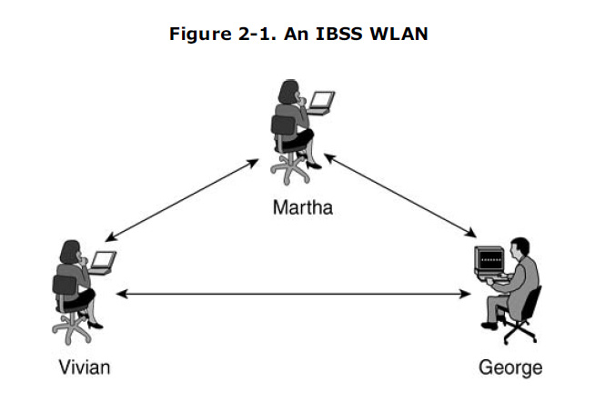
An IBSS consists of a group of 802.11 stations communicating directly with one another. An IBSS is also referred to as an ad-hoc network because it is essentially a simple peer-to-peer WLAN.

Slide 26
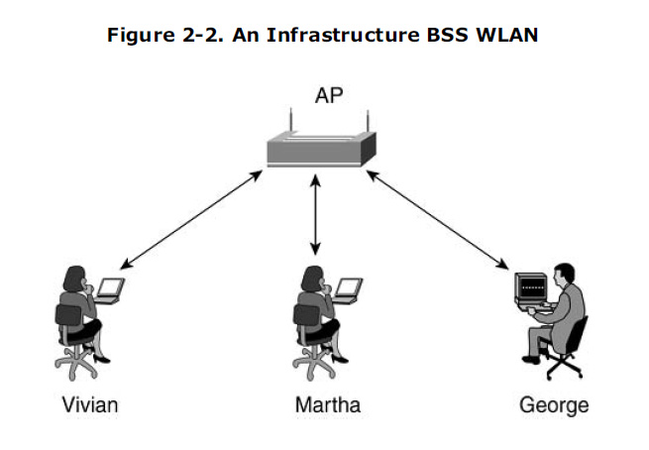

Slide 27
Multiple infrastructure BSSs can be connected via their uplink interfaces.
The uplink interface connects the BSS to the distribution system (DS).
The collection of BSSs interconnected via the DS is known as the ESS.
The uplink to the DS does not have to be via a wired connection.

Slide 28
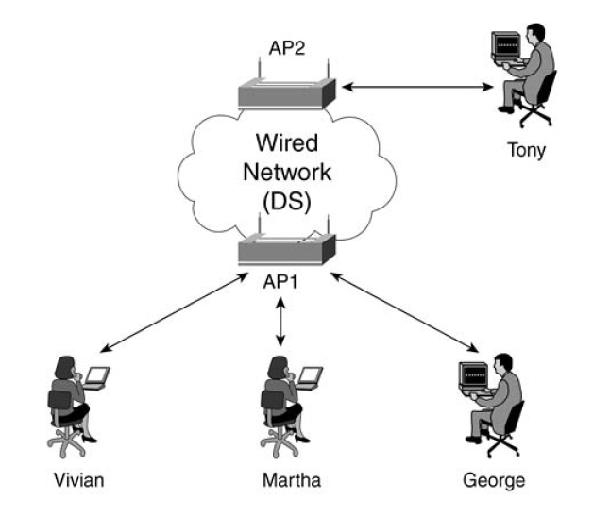

Slide 29
WLAN technologies
Infrared technology
UHF Narrowband technology
Spread spectrum

Slide 30
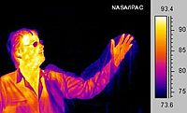
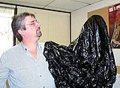
Infrared Technology - Infrared (IR) is invisible radiant energy, electromagnetic radiations with longer wavelengths than those of visible light, extending from the nominal red edge of the visible spectrum at 700 nanometers (frequency 430 THz) to 1 mm (300 GHz).
A comparison of a thermal image and an ordinary photograph shows that a trash bag is transparent but glass (the man's spectacles) is opaque in long-wavelength infrared.
X-rays, microwaves

Slide 31
UHF narrowband technology
Narrowband describes a channel in which the bandwidth of the message does not significantly exceed the channel's coherence bandwidth.
Coherence bandwidth is a statistical measurement of the range of frequencies over which the channel can be considered "flat”.
UHF – Ultra High Frequency
Systems normally transmit in 430 – 470 MHz frequency range rarely 800 MHz range also.

Slide 32
In narrowband RF signal is sent in very narrow bandwidth -12.5 Khz to 25.5 Khz.
Power levels range from 1 to 2 watts
Many UHF are synthesized with radio frequency.
The UHF band is extensively used for satellite communication and broadcasting, in cellular telephone and paging systems, and by third-generation (3G) wireless services.
Channels and sub bands within the UHF portion of the radio spectrum are allocated by the International Telecommunication Union (ITU).

Slide 33
Unprotected /Unlicensed – 430 – 450 MHz (free and open for anyone to use , WIFI)
Protected / Licensed – 450 - 470 MHz (radio stations, Television providers)
UHF wavelengths are short enough that efficient transmitting antennas are small enough to mount on handheld and mobile devices, so these frequencies are used for two way land mobile radio systems, such as walkie talkies, two way radios in vehicles, cordless phones, and cell phones.

Slide 34
Spread spectrum technology
Spread spectrum spreads the transmission power over the entire usable spectrum.
If receiver doesn’t tune to the right frequency then the signal looks like background noise.
The bandwidth of the transmitted signal is much greater than the bandwidth of the original message, and
Two modulation schemes :
Direct sequence spread spectrum (DSSS)
Frequency hopping spread spectrum (FHSS)

Slide 35
DSSS uses narrow band carrier which changes the frequency in pattern known to transmitter and receiver.
FHSS generates redundant bit pattern for each bit to be transmitted. This bit pattern is called spreading code.

Slide 36
IEEE 802.11
IEEE 802.11 is introduced in 1997 for Wireless LAN
Focuses on bottom two layers of OSI layer
Objective : To define MAC sublayers, MAC management protocols and services, three Physical layer is for fixed, portable and moving device with an local area.
Three layers are an IR baseband PHY, FHSS radio in 2.4 GHz band, DSSS radio in 2.4GHz.
WLAN support
Asynchronous data transfer insensitive to time delays
Traffic with bounded time delays with certain QoS

Slide 37
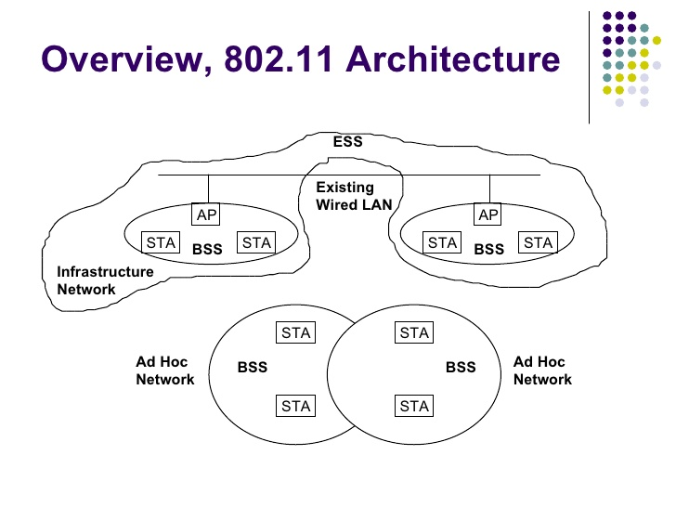
WLAN Architecture

Slide 38
Portable station moves from point to point but is only used at a fixed point.
Mobile stations access the LAN during movement.
When two or more stations come together to communicate with each other, they form a Basic Service Set (BSS).
A BSS that stands alone and is not connected to a base is called an Independent Basic Service Set (IBSS) or is referred to as an Ad-Hoc Network.
An ad-hoc network is a network where stations communicate only peer to peer. There is no base and no one gives permission to talk.

Slide 39
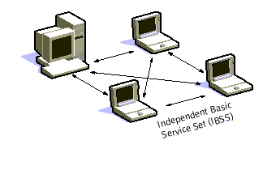
Mostly these networks are spontaneous and can be set up rapidly.
Ad-Hoc or IBSS networks are characteristically limited both temporally and spatially.

Slide 40
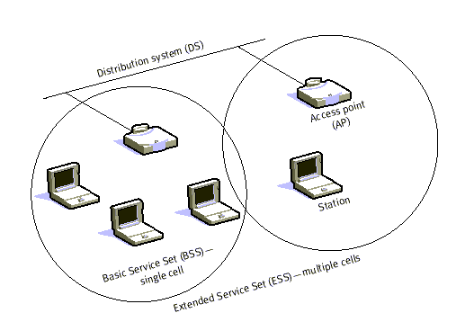
When BSS's are interconnected the network becomes one with infrastructure.
Two or more BSS's are interconnected using a Distribution System or DS.

Slide 41
Entry to the DS is accomplished with the use of Access Points (AP). An access point is a station, thus addressable. So, data moves between the BSS and the DS with the help of these access points.
Creating large and complex networks using BSS's and DS's leads us to the next level of hierarchy, the Extended Service Set or ESS.

Slide 42
IEEE 802.11 Services
Station services:
Authentication – Establishes identity of stations to another
de-authentication – This is invoked whenever existing authentication is to be terminated
Privacy – Prevent the content of messages from being read by other than the intended recipient
delivery of data

Slide 43
Services Cont..
Distribution Services ( A thin layer between MAC and LLC sublayer)
Association – Establishes initial association between station and an AP.
Disassociation – A notification from either a station or AP that an existing association is terminated.
Reassociation – Enables an established association to be transferred from one AP to another
Distribution – Primary service used by stations to exchange MAC frames between BSS.
Integration – Integration service takes care of any address translation and media conversion logic required for exchange of data.

Slide 44
Physical Layer
Physical Layer provides three levels of Functionality
PLCP (Physical Layer Convergence Procedure): frame exchange between the MAC and PHY
PMD (Physical Medium Dependent) : uses signal carrier and spread spectrum modulation to transmit data frames over the media.
Provides a carrier sense indication back to the MAC to verify activity on the media.
Direct Sequence Spread Spectrum (DSSS) PHY
2.4 GHz : RF : 1 – 2 Mbps
The Frequency Hopping Spread Spectrum (FHSS) PHY
110KHz deviation : RF : PMD controls channel hopping : 2 Mbps
Infrared (IR) PHY
Indoor : IR : 1 and 2 Mbps
The OFDM PHY – IEEE 802.11a
5.0 GHz : 6-54 Mbps :
High Rate DSSS PHY – IEEE 802.11b
2.4 GHz : 5.5 Mbps – 11 Mbps :

Slide 45
MAC Sublayer frame of IEEE 802.11
The 802.11 MAC sublayer provides an abstraction of the physical layer to the logical link control sublayer and upper layers of the OSI network. It is responsible for encapsulating frames and describing frame formats.
MAC Sublayer frame of IEEE 802.11
The main fields of a frame of wireless LANs as laid down by IEEE 802.11 are −
Frame Control − It is a 2 bytes starting field composed of 11 subfields. It contains control information of the frame.
Duration − It is a 2-byte field that specifies the time period for which the frame and its acknowledgement occupy the channel.
Address fields − There are three 6-byte address fields containing addresses of source, immediate destination and final endpoint respectively.
Sequence − It a 2 bytes field that stores the frame numbers.
Data − This is a variable sized field carries the data from the upper layers. The maximum size of data field is 2312 bytes.
Check Sequence − It is a 4-byte field containing error detection information.

Slide 46
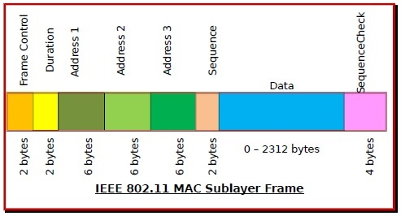

Slide 47
Avoidance of Collisions by 802.11 MAC Sublayer
In wireless systems, the method of collision detection does not work. It uses a protocol called carrier sense multiple access with collision avoidance (CSMA/CA).
The method of CSMA/CA is −
When a frame is ready, the transmitting station checks whether the channel is idle or busy.
If the channel is busy, the station waits until the channel becomes idle.
If the channel is idle, the station waits for an Inter-frame gap (IFG) amount of time and then sends the frame.
After sending the frame, it sets a timer.
The station then waits for acknowledgement from the receiver. If it receives the acknowledgement before expiry of timer, it marks a successful transmission.
Otherwise, it waits for a back-off time period and restarts the algorithm.

Slide 48
Co-ordination Functions in 802.11 MAC Sublayer
IEEE 802.11 MAC Sublayer uses two co-ordination functions for collision avoidance before transmission −
Distributed Coordination Function (DCF) −
It is a mandatory function used in CSMA/CA.
It is used in distributed contention-based channel access.
It is deployed in both Infrastructure BSS (basic service set) as well as Independent BSS.
Point Coordination Function (PCF) −
It is an optional function used by 802.11 MAC Sublayer.
It is used in centralized contention-free channel access.
It is deployed in Infrastructure BSS only.

Slide 49
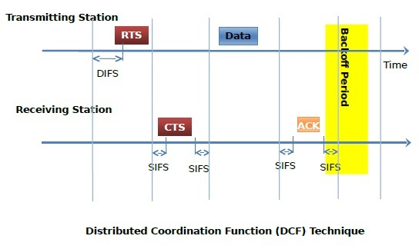
The random backoff time is defined by a contention window having a random number of time slots.
At the end of the backoff period, if the channel is clear, the station will wait for an amount of time equal to DIFS (Distributed Inter-Frame Space) and sense the channel again.
After the frames are sent, the transmitting station waits for a time equal to SIFS (Short Inter-Frame Space) for the acknowledgement.

Slide 50
MAC Management
Interference by users that have no concept of data communication. Ex: Microwave
Interference by other WLANs
Security of data
Mobility
Power Management

Slide 51
Other Standards
High performance radio local area network (HIPHERLAN) family of standards
It works with lower portion of the OSI reference model
DL layer is divided into Channel Access Control (CAC) and MAC
CAC defines how a given channel access attempt will be made depending on whether the channel is busy or idle and at what priority level an attempt will be made.
HIPERLAN MAC layer defines the various protocols which provide the HIPERLAN/1 features of power conservation, security, and multihop routing (i.e., support for forwarding), as well as the data transfer service to the upper layers of protocols.

Slide 52
Cont..
HIPERLAN/2 has three basic layers: physical layer (PHY), data link control layer (DLC), and convergence layer (CL)
The convergence layer (CL) between the data link layer and network layer provides QoS.
Multimedia Access Communication — High Speed Wireless Access Network (HiSWAN)
It uses two frequency bands: 5 GHz for HiSWANa and 25 GHz for HiSWANb.
HiSWAN uses the OFDM physical layer to provide a standard speed of 27 Mbps and 6 to 36 Mbps by link adaptation.

